Slide 1
Image classification
Done By
Heba Alabdulltif
Danah Alasfour

Slide 2
01
Summary
LIST OF CONTENTS
02
Compare between techniques(DNN AND CNN)
03
Graph
04
Compare between Activations
08
Conclusion

Slide 3

Summary

Slide 4

Image classification is the process of categorizing an image into a specific class or label based on its content. This is done using artificial intelligence techniques, especially Deep Neural Networks (DNNs) which are a type of advanced neural networks with multiple layers that can learn complex patterns in data.
One popular type of DNN used for image classification is Convolutional Neural Networks (CNNs). CNNs are designed to handle images efficiently by automatically extracting important features like edges, shapes, and patterns from the images, without the need for manual feature extraction.
Using DNNs like CNNs, an image is classified into a category based on the patterns the network has learned during training. This makes image classification very useful in applications like face recognition, medical imaging, self-driving cars, and other areas where accurate image analysis is needed.

Slide 5
Our code classifies images, so we created two separate codes so that each code uses a different technique. They were chosen from the research paper that we read, namely DNN and CNN, and we will compare them.
Compare Techniques

Slide 6
Criterion | DNN (Deep Neural Network) | CNN (Convolutional Neural Network)
Definition | A network consisting of multiple layers where each layer is connected to all previous layers | A network specifically designed for image analysis and pattern recognition
Working Method | Transforms the image into a row of numbers | Uses convolutional layers to directly detect patterns in the image
Efficiency | May require more time to learn due to handling a large amount of data | Learns faster because it uses information more efficiently
Performance and Accuracy | Lower accuracy | Higher accuracy
Detail Understanding | Less capable of seeing fine details in images | Can see all details in the image more clearly
Computation Reduction | Requires more computational operations due to the large data size | Uses methods like pooling to reduce information
Example | Like coloring each part of the image individually | Like seeing the whole image and quickly knowing where to place colors
DNN | It divides images into parts and each part detects patterns which it contains and thus loses some important and small details because they will not be clear when divided.
CNN | It sees the entire image and detects patterns without losing any of the important and small details in the picture.

Slide 7
Graph

Slide 8

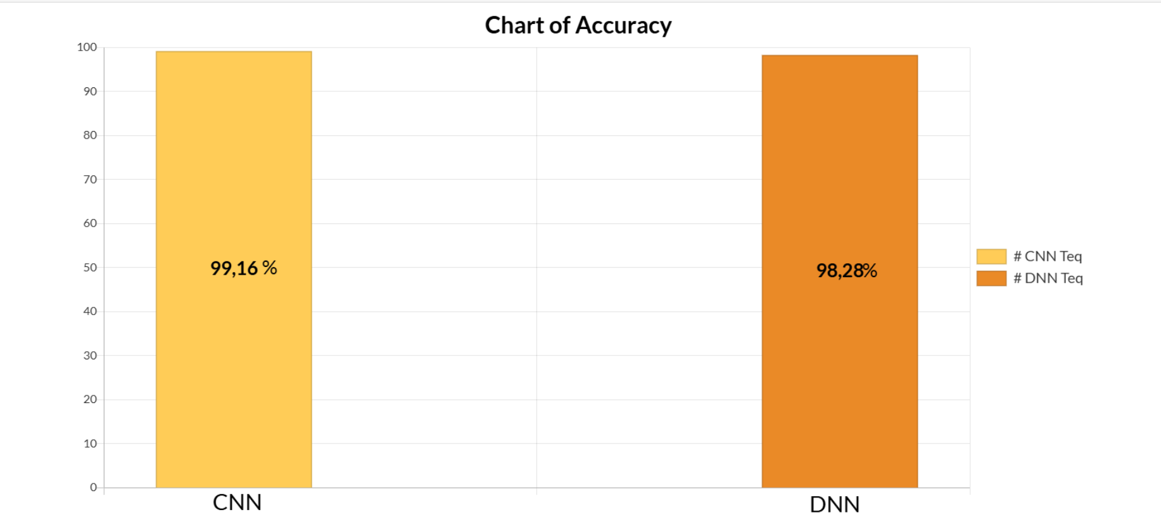
This chart shows how accurate two systems are: "CNN" and "DNN."
CNN (Convolutional Neural Network) has an accuracy of 99.16%, which means it did a really great job.
DNN (Deep Neural Network) has an accuracy of 98.28%, which is also good but not as high as CNN.
The colors help us see the difference: yellow for CNN and orange for DNN. The higher the number, the better the result!

Slide 9
In our code we have used an activation function, which in turn is used in neural networks to determine whether a neuron should fire or not based on the input it receives. It has many types. We will compare three types(ReLU, Softmax,Tanh), two of which we used in our code.
Compare Activation

Slide 10
Activation | How does it work? | pros | cons | Why is it use?
RelU | It determines whether the features in the image are important or not, so if the value is large (positive) it remains, but if it is small (zero or negative) it equates it to zero, meaning it removes it. | -It makes learning the model faster because it only focuses on the important features. -Gradient fade relief. | -It makes all negative features equal to zero, so if there is an image with all its features equal to zero, it will delete it, and this may lead to ignoring some important images. -It outputs some images as zero and this may affect the classification of images. | Preferred in deep networks because it promotes fast learning.
Tanh | It identifies important and unimportant features in images, classifying unimportant features with negative values ​​close to -1, and if the features are important, it classifies them with positive values ​​close to 1. | -Balance values ​​around zero, allowing the model to learn from both negative and positive features. | -Slower than ReLU. -Cannot handle zero values. | Good in certain cases where you need to distribute values ​​evenly and also in hidden layers, but less used than ReLU.
Softmax | It takes a set of values ​​produced by the layers and converts these values ​​into probabilities between 0 and 1, so that the value with the greatest probability is the correct image or correct probability. This is done at the end of the construction. | -Provides clear possibilities as to how the classification is done. -Reduce dominance: reduce the impact of large values ​​on the output. | -It is not used in hidden layers, it is only used in the last layer. -It is affected by the distribution of data. If the data is focused on a specific category, this will affect the model’s learning and the accuracy of its predictions. | It is used when you want to specify one category from a group of categories, and it is only in the last layer.

Slide 11
Conclusion

Slide 12
In the end, we see that image classification is one of the tasks that has become important for many fields, including the medical field. Therefore, the ability of intelligence to classify has become one of the things that has helped in the field of medicine and other fields, so that classification has become more accurate. This can be done using different types of techniques, but during the work of our project we found that using CNN technology is better at classifying images than DNN technology. It showed an accuracy rate of 99.16, so it is preferable to use it more than others in classification.

Slide 13
THANKS
FOR WATCHING
https://github.com/Danah7689/Image-Classification.git

